Slide 1
BATSRUS Results

Slide 2
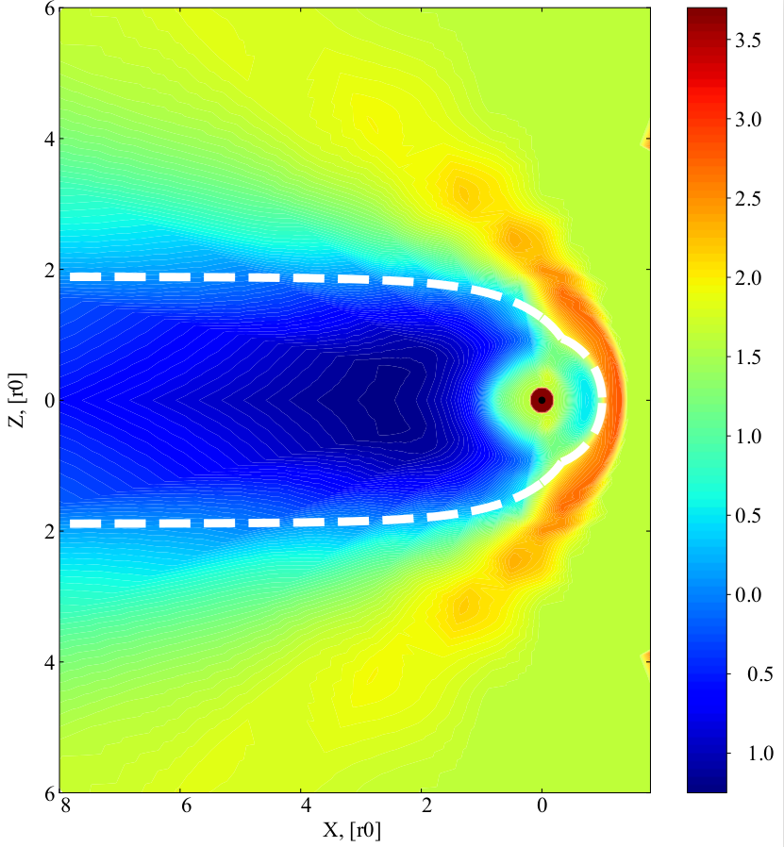
Earth in the Solar wind
Contours of log(N)
y=0 plane cut, units normalized to standoff distance of ~10 Re.
dashed line is analytical magnetopause solution.`
Wind conditions
N = 5 / cc (H+)
Ux = 400 km/s
Uy = 0
Uz = 0
Bx = 0
By = 0
Bz = 5 nT

Slide 3
Problem: wire loop in orbit at ~500 km in Low Earth Orbit
X - along orbital motion
Y - to Earth center
Z - vertical
Z
Wind conditions
N = 500,000 / cc (H+)
Ux = 7.6 km/s
Uy = 0
Uz = 0
Bx = 0
By = 0
Bz = 25,000 nT
Y
X

Slide 4
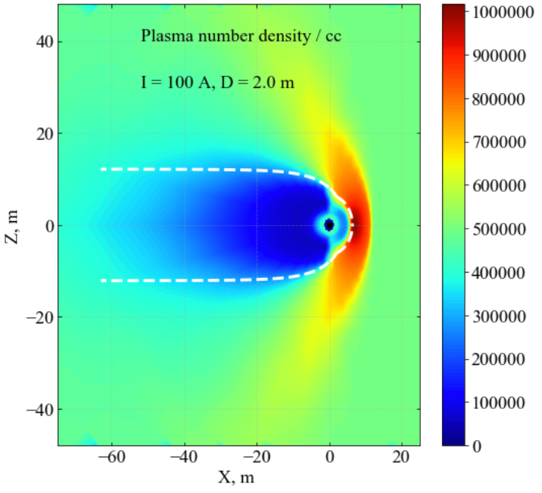
Dipole with plasma wind in Earth orbit (without Earth’s field)
Dipole with 1 m radius and magnetic moment equivalent to a 1.0 radius loop with 100 A current.
Contours of N
y=0 plane cut, units of m.
dashed line is analytical magnetopause solution
Earth’s B-field of around 25000nT is not added to #SOLARWIND.

Slide 5
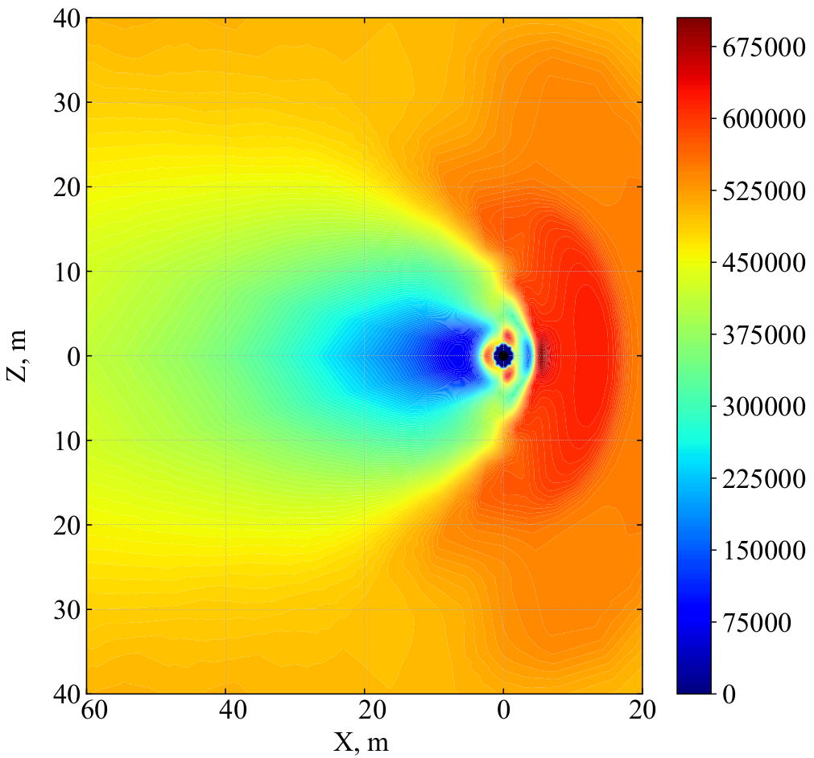
Dipole with plasma wind in Earth orbit (with Bz=250 nT)

Slide 6
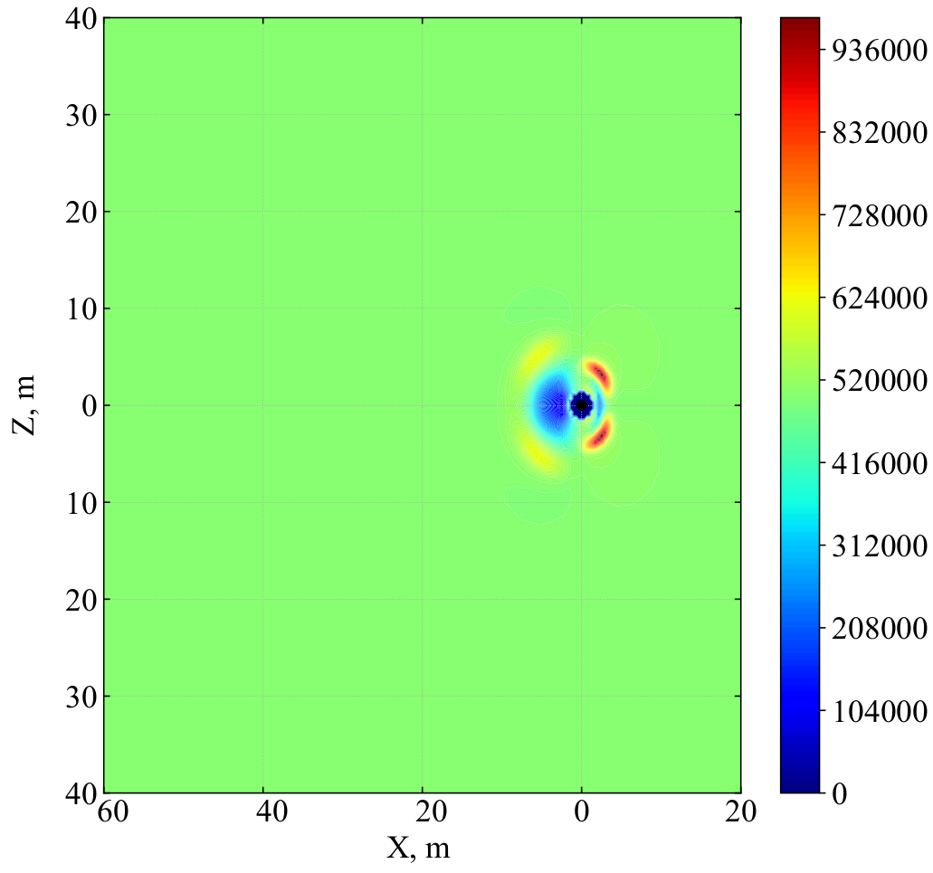
Dipole with plasma wind in Earth orbit (with Bz=2500 nT)

Slide 7
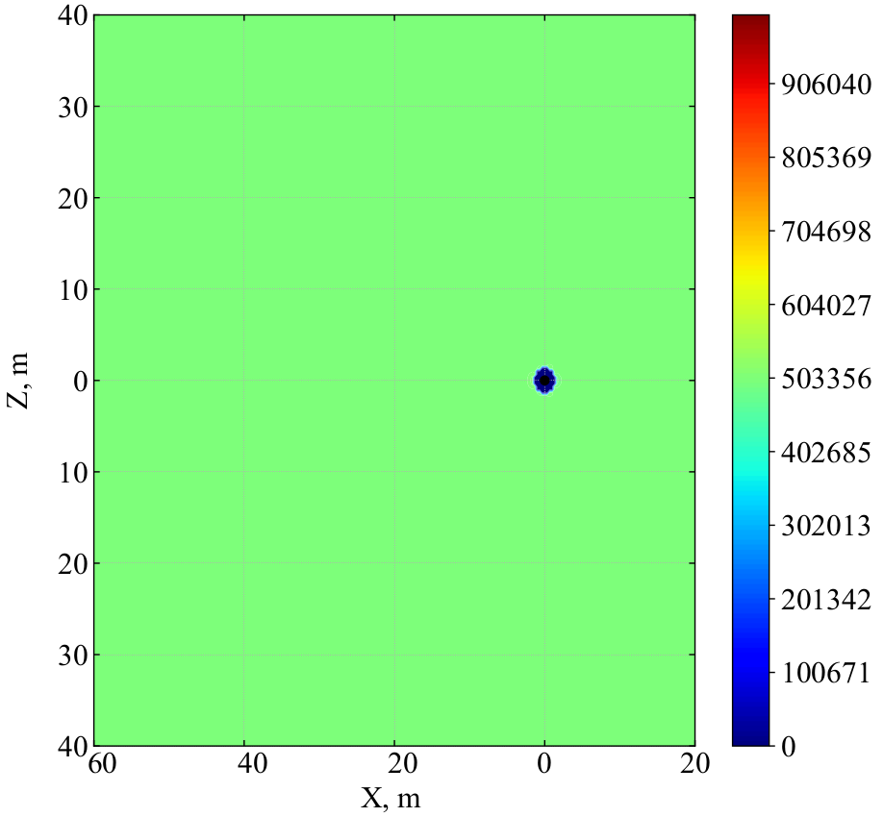
Dipole with plasma wind in Earth orbit (with Bz=25000 nT)

